Slide 1
NUTRITION AI AGENT
IBM PROJECT
Presented By:
Student name : Sudipta Chatterjee
College Name & Department : Amity University

Slide 2
OUTLINE
Problem Statement
Technology used
Wow factor
End users
Result
Conclusion
Git-hub Link
Future scope
IBM Certifications

Slide 3
PROBLEM STATEMENT
Despite the growing awareness of healthy eating habits, a significant portion of the population struggles to maintain balanced diets due to lack of personalized nutritional guidance, limited access to expert advice, and misinformation online. This results in poor health outcomes including obesity, malnutrition, and lifestyle-related diseases.
Proposed Solution: An AI Research Agent that uses Natural Language Processing (NLP), Retrieval-Augmented Generation (RAG). This AI-powered assistant would analyze individual data such as age, weight, health conditions, and lifestyle habits to generate custom meal plans, offer grocery suggestions, and monitor daily nutrient intake. It would also educate users with timely tips and alerts, adapting its recommendations based on progress and feedback to foster long-term wellness and informed food choices—all in a simple, accessible format.

Slide 4
TECHNOLOGY USED
IBM cloud lite services
Natural Language Processing (NLP)
Retrieval Augmented Generation (RAG)
IBM Granite model

Slide 5
IBM CLOUD SERVICES USED
IBM Cloud Watsonx AI Studio
IBM Cloud Watsonx AI runtime
IBM Cloud Agent Lab
IBM Granite foundation model

Slide 6
WOW FACTORS
Imagine a Nutrition Agent that doesn’t just suggest healthy meals but transforms food into a personal wellness journey. It uses AI and real-time data to:
🧠 Anticipate cravings and gently nudge healthier swaps before impulse takes over
🍽️ Auto-generate weekly menus synced with local produce and seasonal ingredients
🛒 Integrate with smart grocery platforms to create curated shopping lists—or even place orders
👩‍⚕️ Sync with wearables to adjust meal plans dynamically based on your sleep, activity, and mood
🎮 Gamify nutrition goals with streaks, challenges, and unlockable rewards to keep users motivated
It’s not just a guide—it’s a wellness sidekick that evolves with you, celebrating the small wins and helping you stay one bite ahead

Slide 7
END USERS
Health-conscious individuals
Patients with dietary restrictions
Dietitians
Fitness enthusiasts and athletes

Slide 8
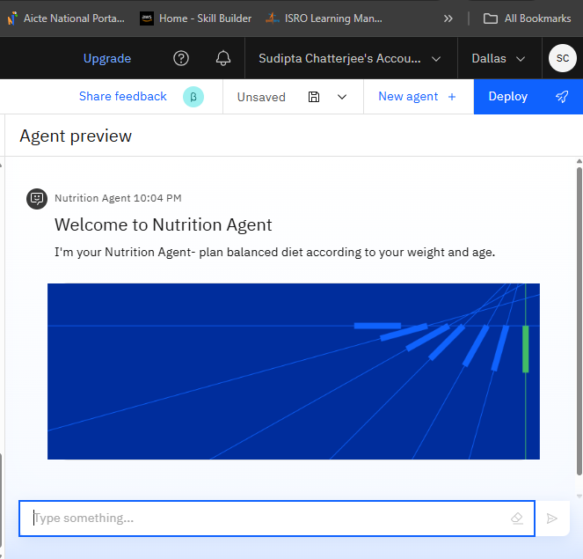
RESULTS

Slide 9
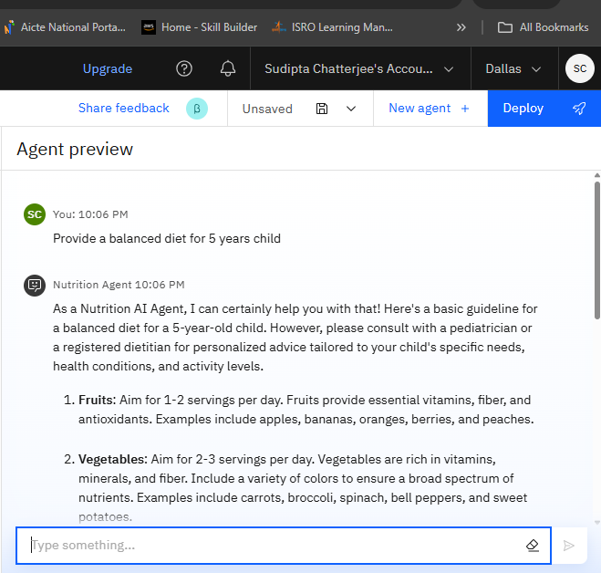
RESULTS

Slide 10
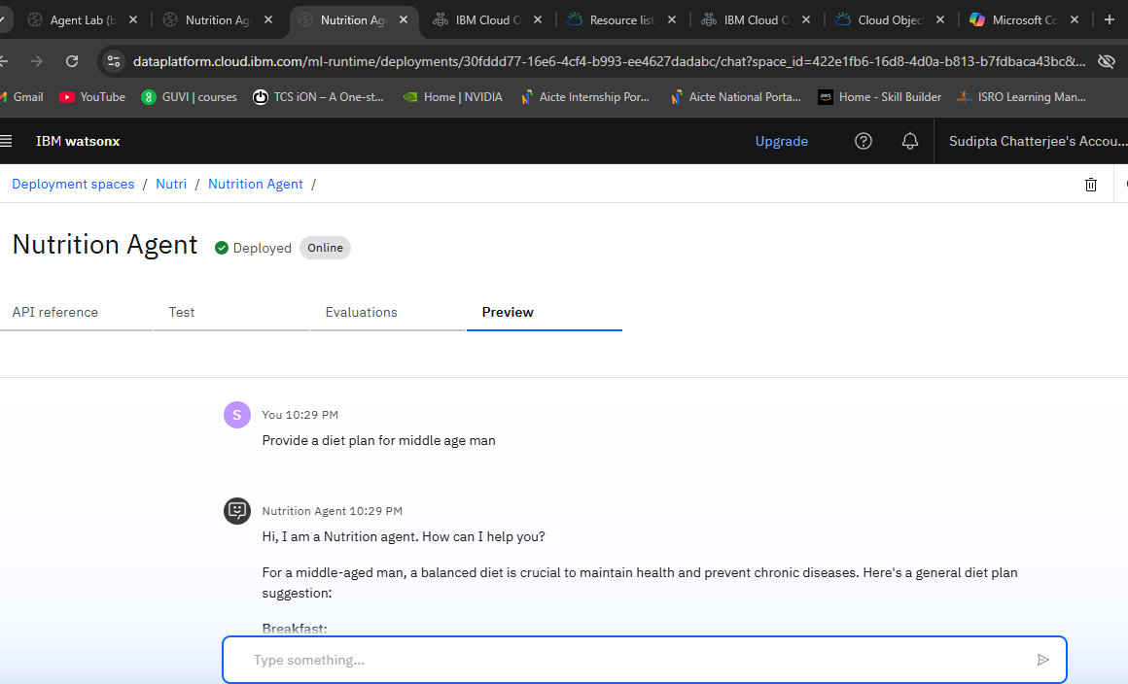
RESULTS
Deployed AI Agent

Slide 11
CONCLUSION
The agent can offers tailored nutritional guidance based on personal health data.
It saves time by simplifies meal planning, grocery shopping, and intake tracking.
Promotes healthier lifestyles and long-term wellness goals
Acts as a proactive, engaging wellness companion—beyond just a tool.

Slide 12
GITHUB LINK
Make sure that there should be readme file

Slide 13
FUTURE SCOPE
Multilingual and Cultural Expansion
Voice-Activated Assistant
Real-Time Collaboration Features
Sustainability Tracking
Wearable & IoT Syncing
Healthcare Collaboration

Slide 14
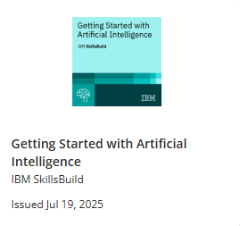
IBM CERTIFICATIONS

Slide 15
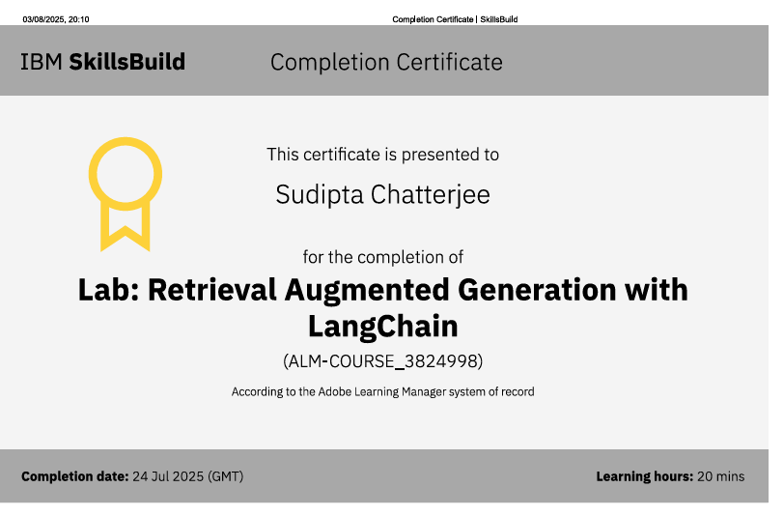
RAG LAB certificate

Slide 16
THANK YOU

